Slide 1
GROUP-1
By:-
Alex Schell - 12548926
Riley Bruce - 14179761
Shaik Mohammed Zubaidi - 16353803

Slide 2
Feature extraction
We separated the COVID and normal images
Then we applied the grayscale and flattened the images
Mean-centered the images to get the data ready for PCA

Slide 3
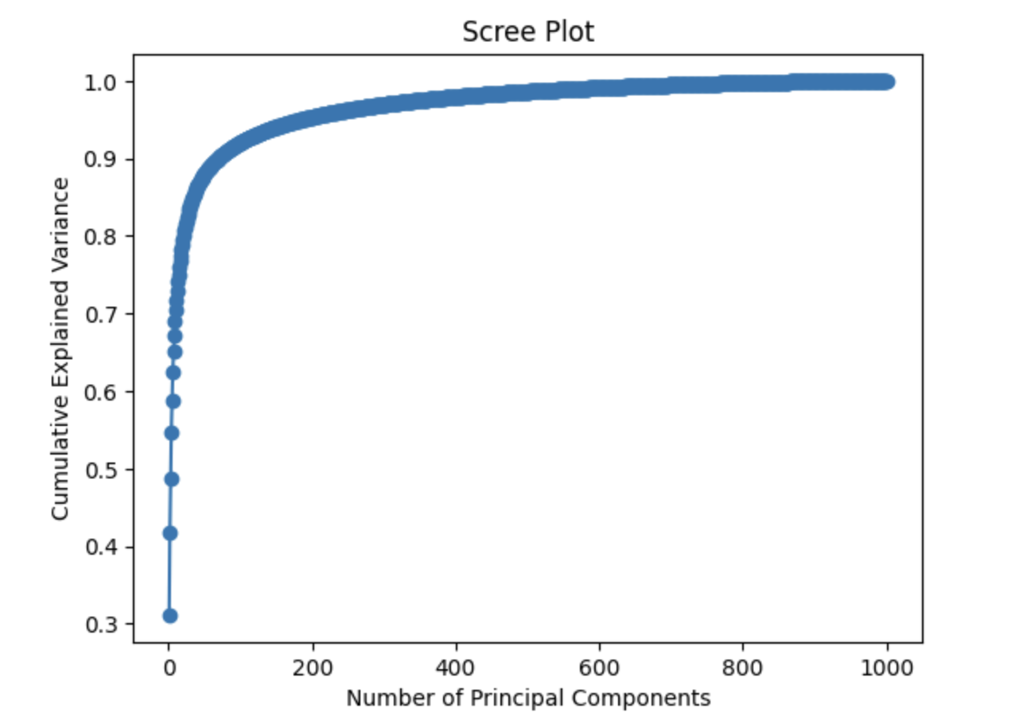
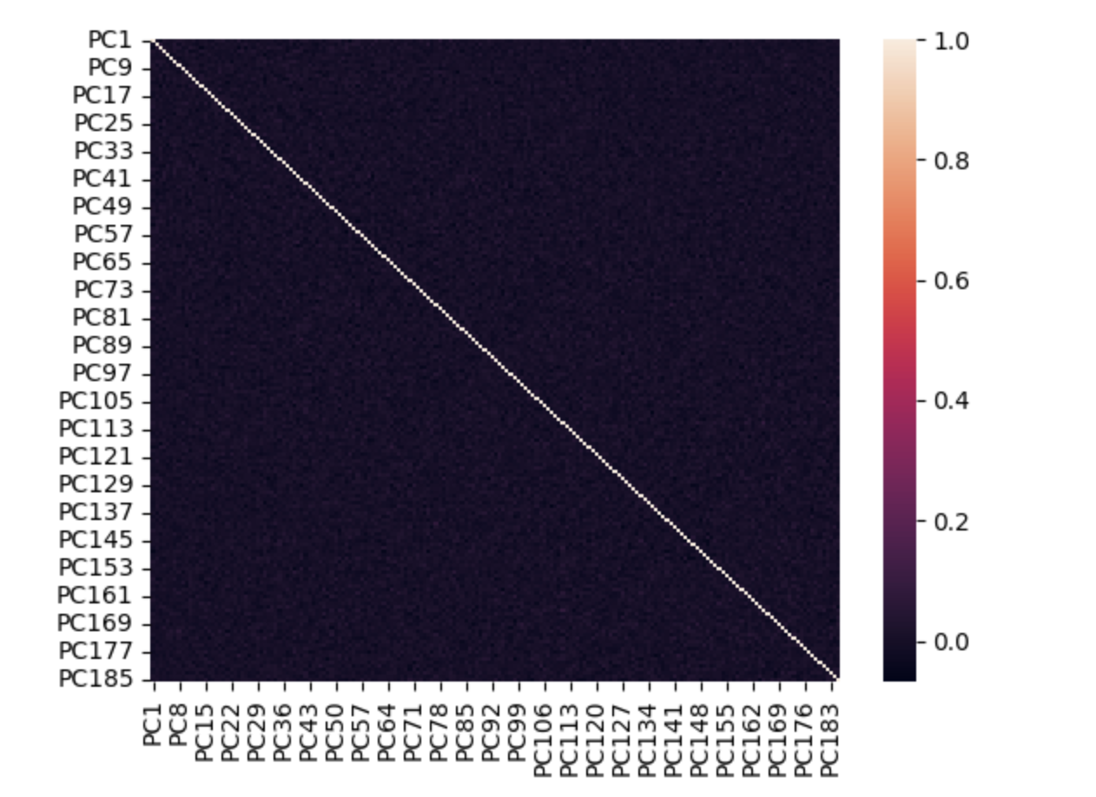
PCA

Slide 4
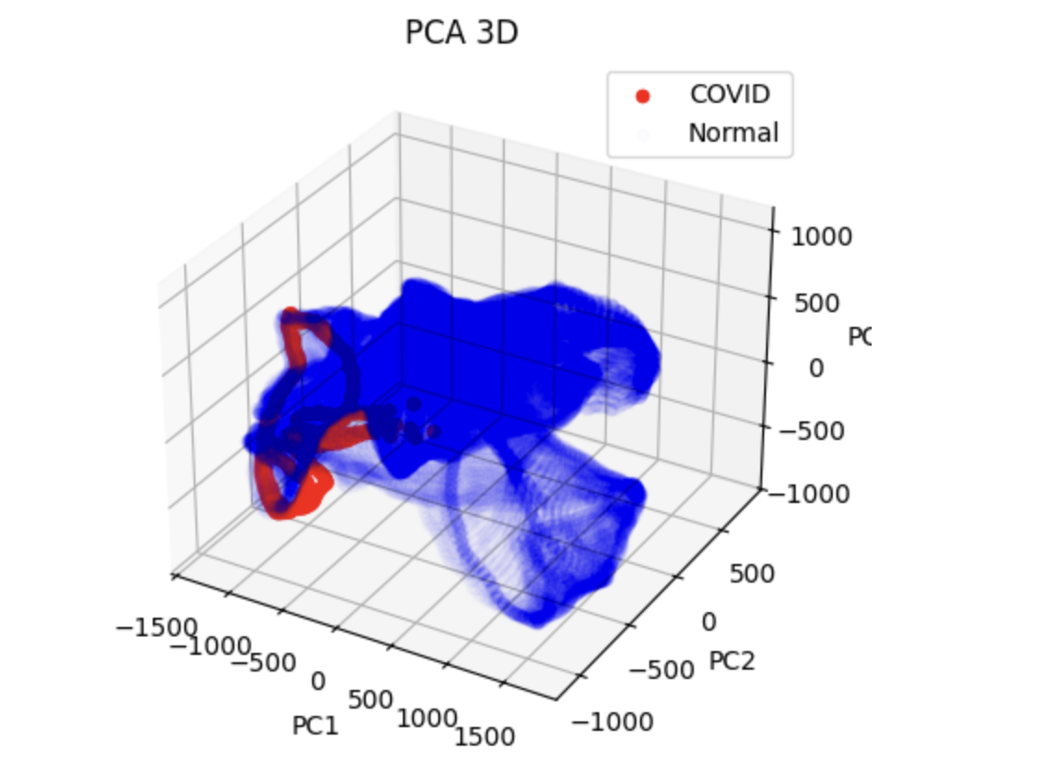
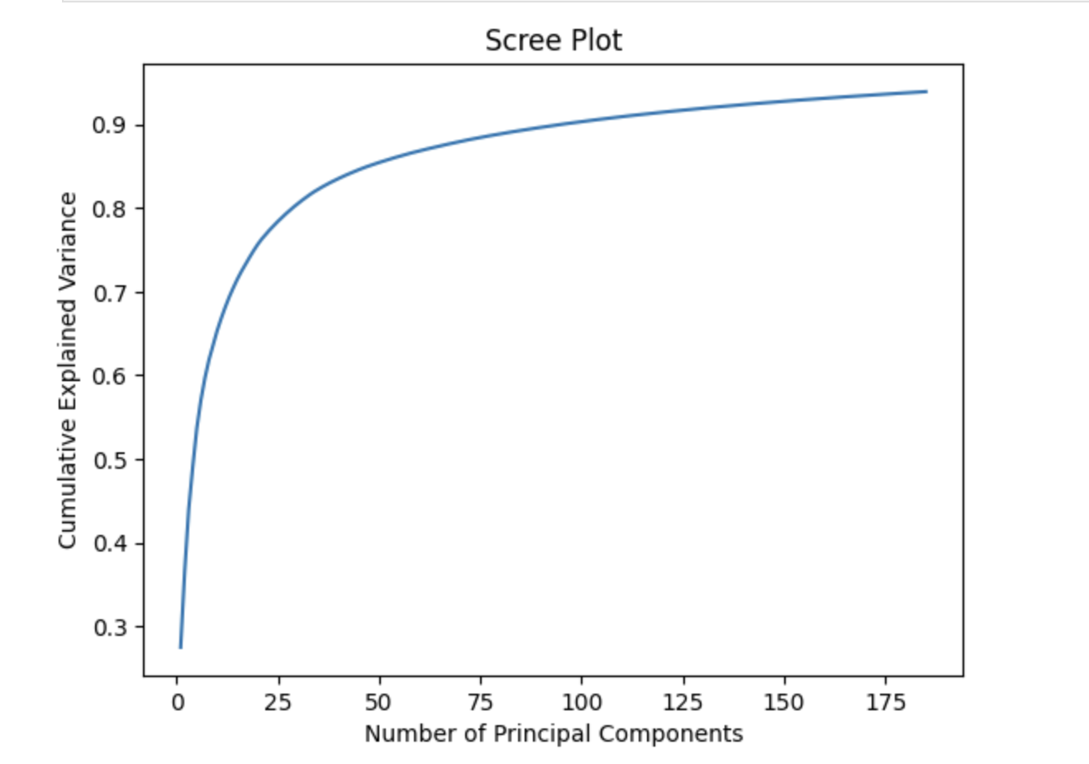
PCA

Slide 5
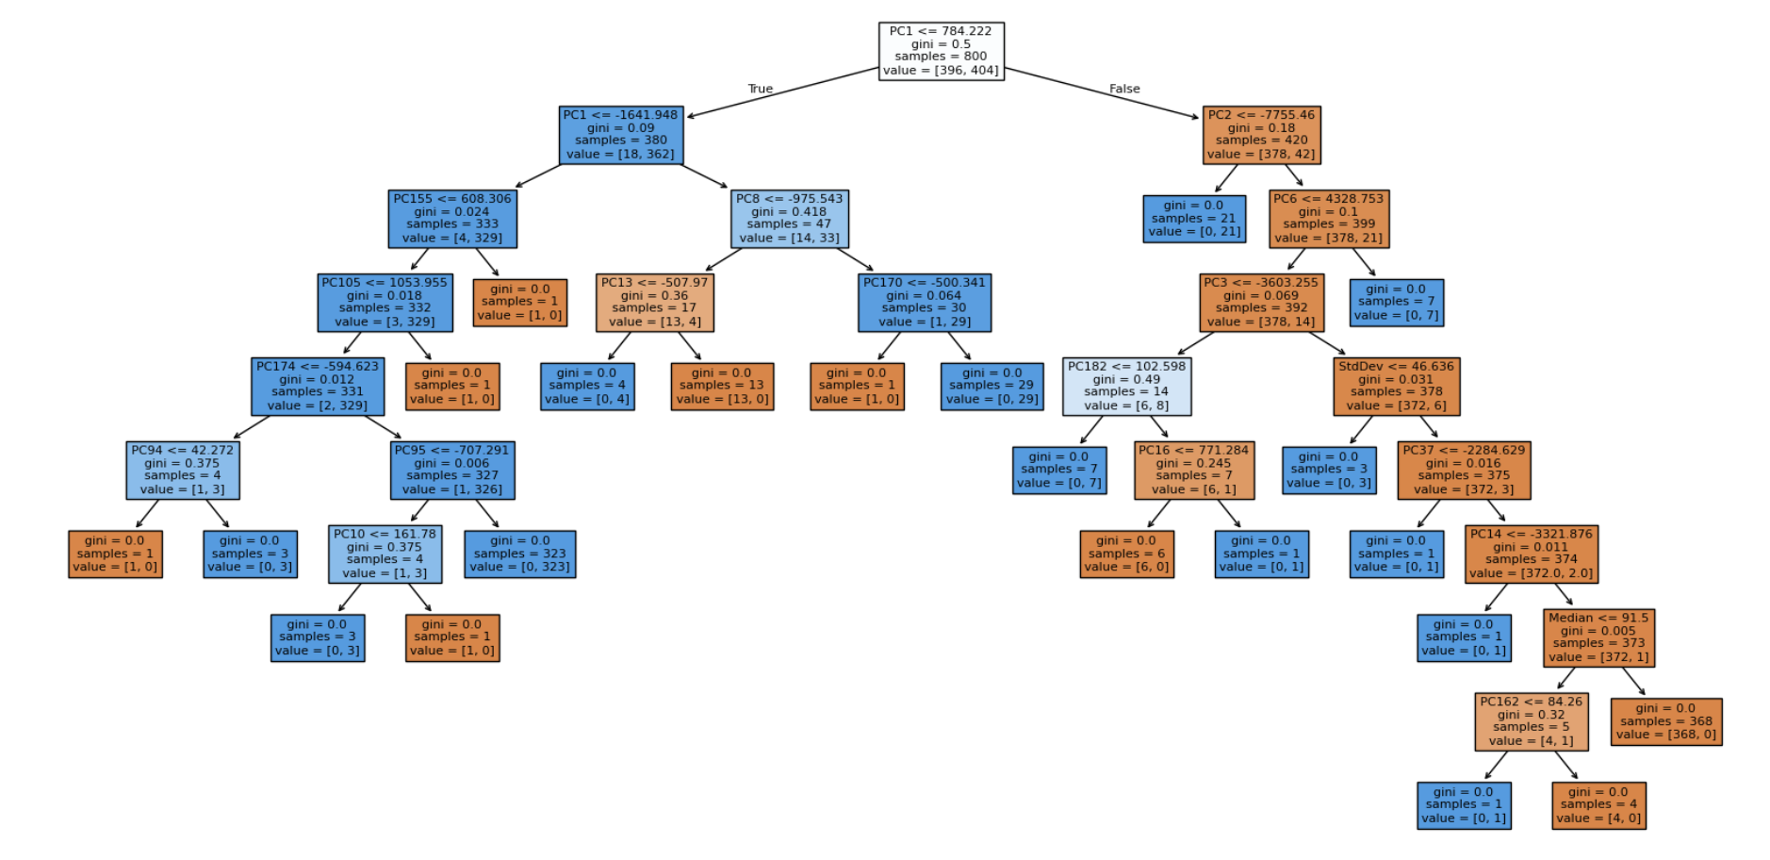
Decision Trees
Baseline Decision Tree
CV Accuracy - 0.93

